Slide 1

NETSAGE AI
AI-Powered Cisco Packet Tracer Troubleshooting Assistant
Tagline: Diagnose. Validate. Resolve. Learn.
Presented by: NetSage AI Team — Technology: React | FastAPI | Python | Cisco Packet Tracer

Slide 2

The Problem
Network troubleshooting in Cisco Packet Tracer is time-consuming and challenging for learners:
Root-cause identification from symptoms is difficult.
Cisco CLI output can be dense and hard to interpret.
Beginners rely on trial-and-error and don’t know which command to run next.
Troubleshooting spans multiple OSI layers and protocols without a structured workflow.
No built-in method to validate or verify recommended fixes.
Common trouble areas: VLAN · OSPF · DHCP · DNS · ACL · NAT · Wireless

Slide 3
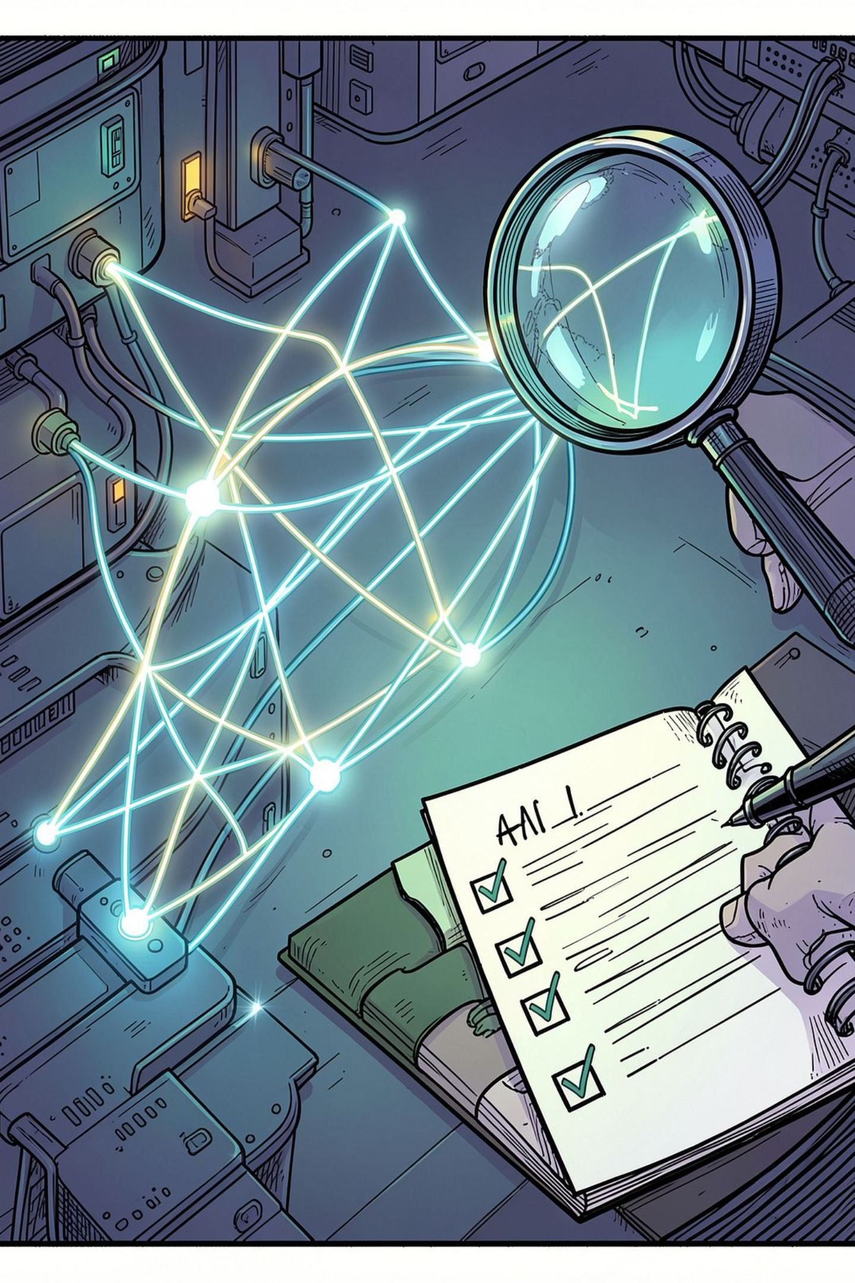




Introducing NetSage AI
NetSage AI converts symptoms, Cisco CLI evidence and topology notes into a structured, explainable troubleshooting workflow — accelerating diagnosis while preserving human oversight.
User Input
Symptoms, CLI output, topology context, fault category.
NetSage Engine
Diagnostic reasoning + deterministic rule validation.
Output
Root cause, evidence, verification & remediation commands.
Human Review
Accept · Edit · Reject — creates auditable records.

Slide 4
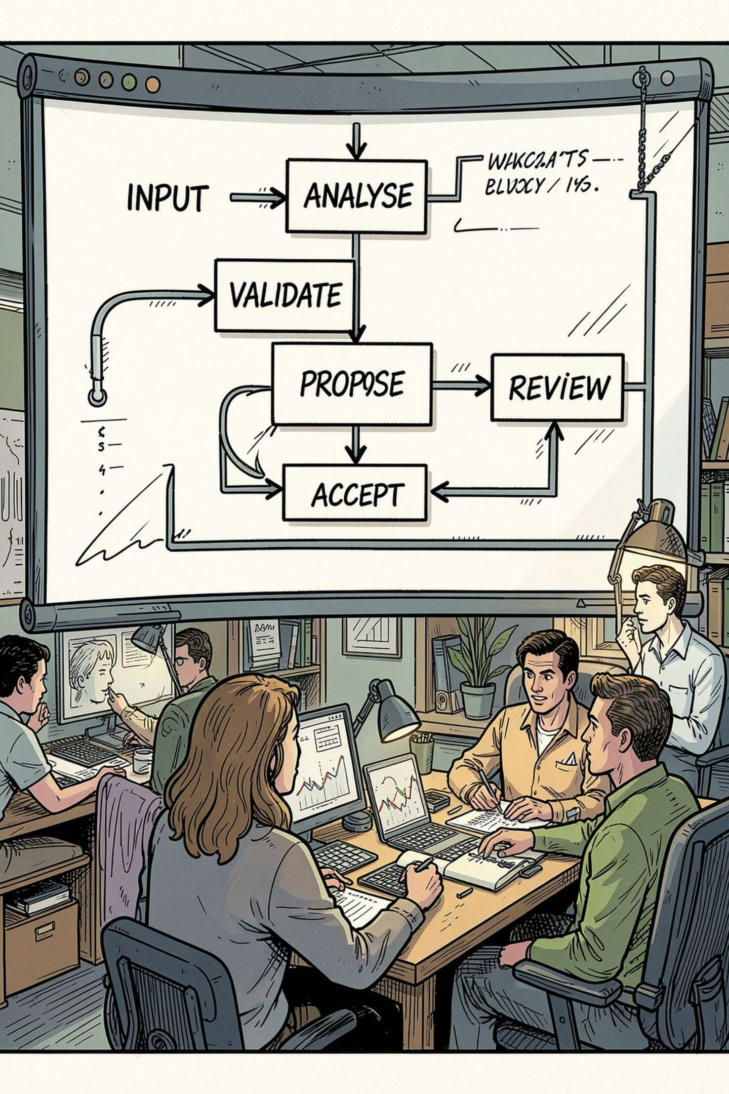
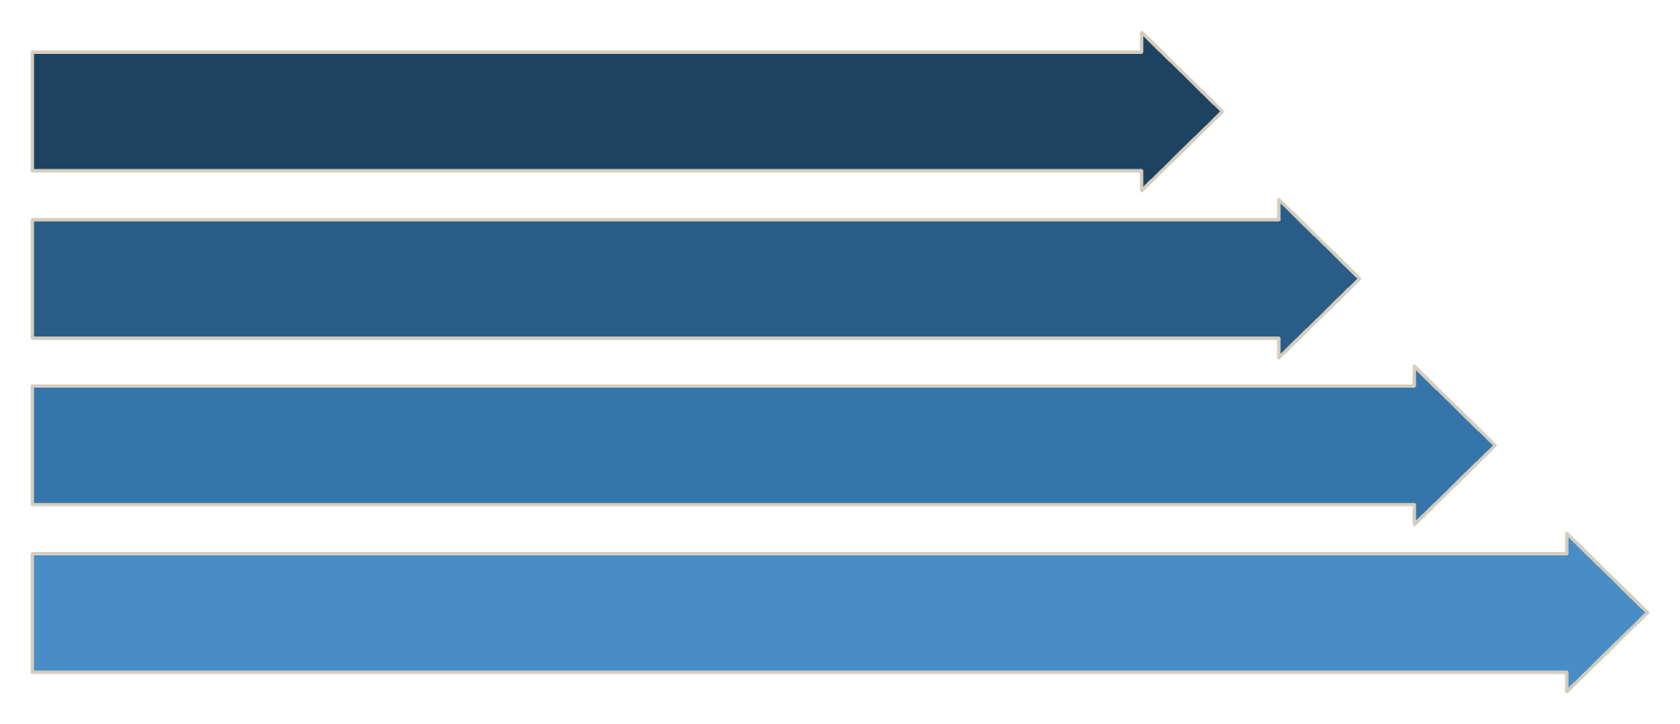
Troubleshooting Workflow
Streamlined process designed for clarity and repeatability:
Network Problem
Enter Symptoms
Cisco CLI
Topology Context
Final output includes: Root Cause, Confidence, Severity, OSI Layer, Evidence, Verification command, Remediation commands, Step‑by‑step guide.

Slide 5

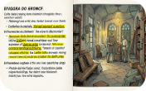

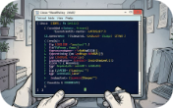


Key Features
Smart Diagnosis
Evidence‑Based Results
Rule Validation
Cisco IOS Guidance
Probabilistic identification of likely configuration faults with ranked hypotheses.
Deterministic checks confirm whether remediation steps resolve the issue.
Explicit CLI excerpts tied to each diagnosis for auditability and teaching moments.
Verification and remediation command snippets formatted for immediate use in Packet Tracer.
Human-in-the-Loop
History & Analytics
Reviewer workflow to Accept, Edit or Reject — keeps experts in control.
Searchable diagnostic history and dashboards for pattern discovery and pedagogy.

Slide 6
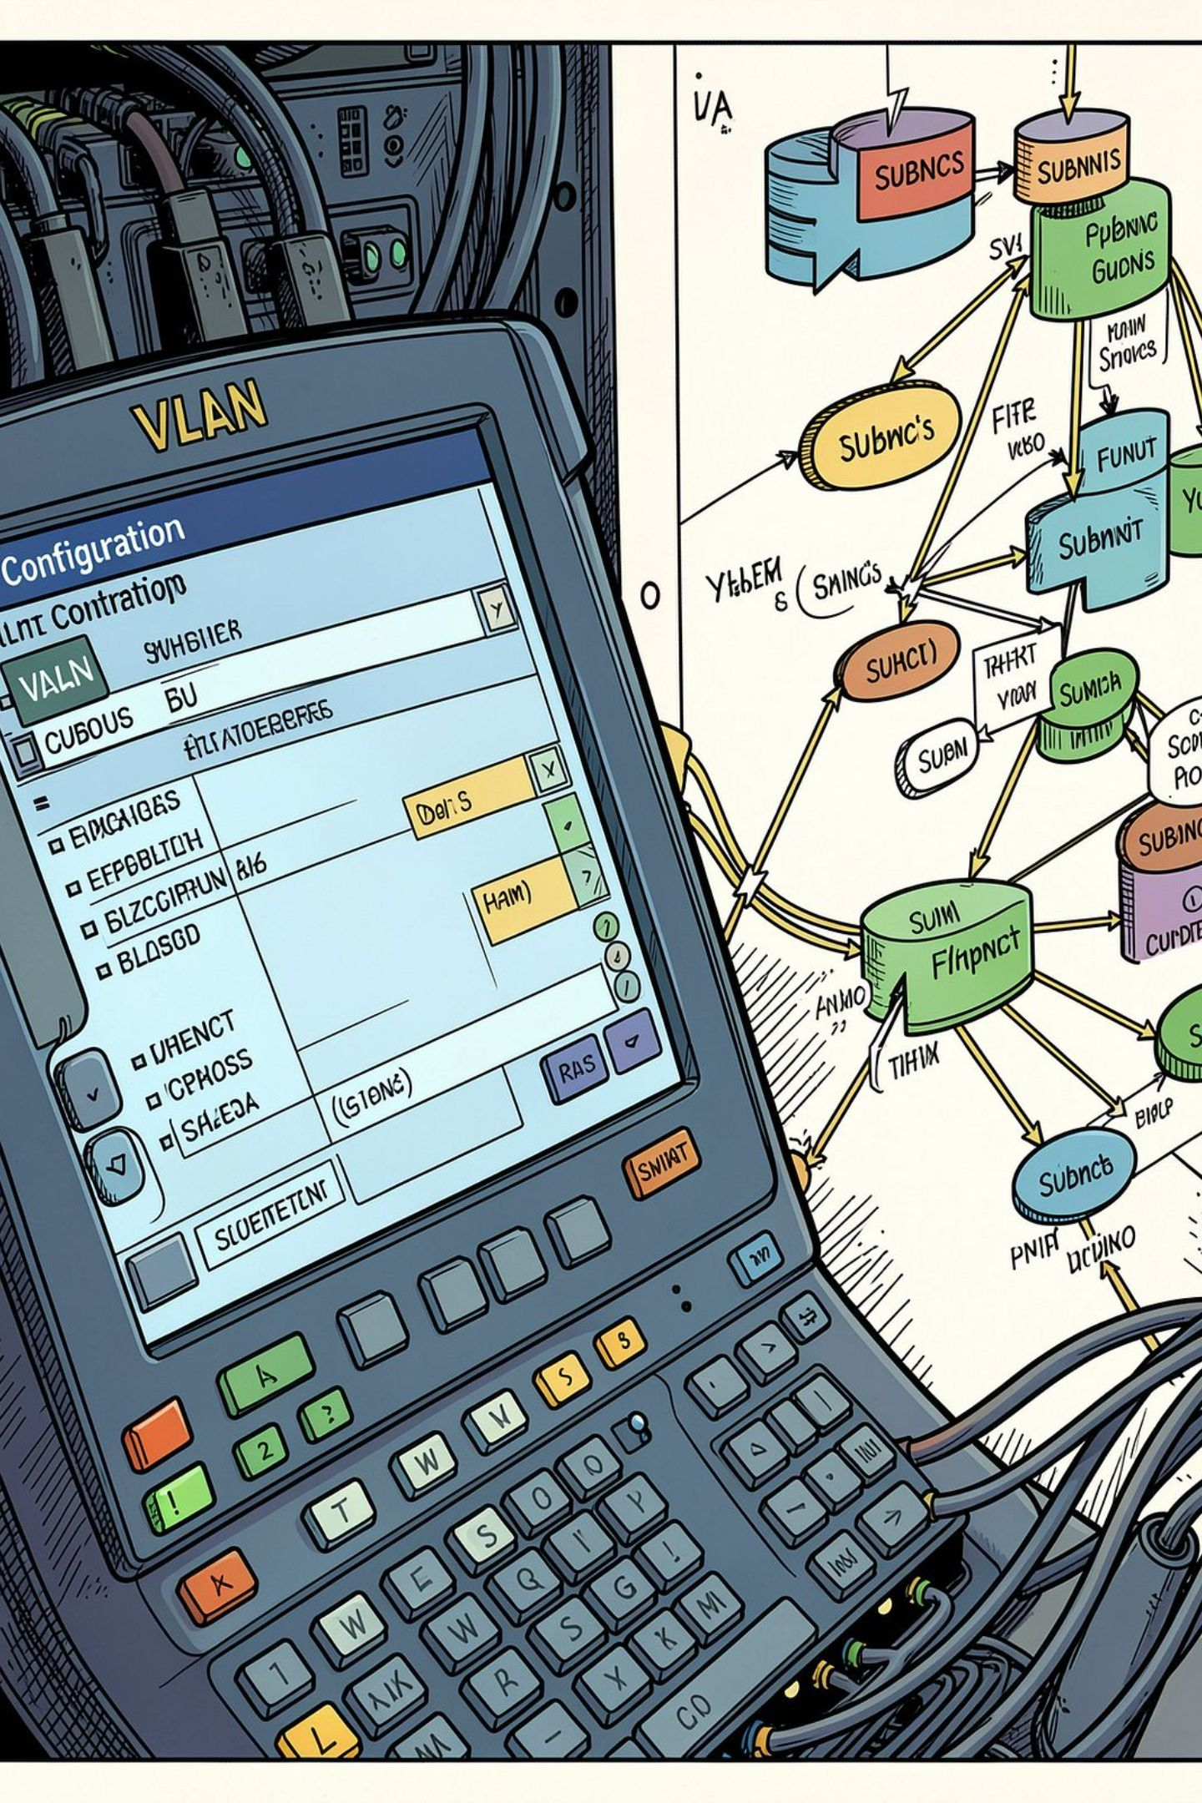
Supported Network Problems
NetSage AI targets common Packet Tracer scenarios across protocol domains and OSI layers:
Areas & Example Faults
Troubleshooting Commands
VLAN — mismatch, access/trunk misconfig
OSPF — adjacency failures, area/type mismatch
DHCP — pool exhaustion, binding issues
DNS — resolution failures, misconfigured servers
ACL — unintended blocks, ordering mistakes
NAT — translation failures, incorrect interfaces
Wireless — authentication and association problems
Common verification commands NetSage highlights:
show vlan brief
show interfaces trunk
show ip ospf neighbor
show ip dhcp binding
show access-lists
show ip nat translations

Slide 7
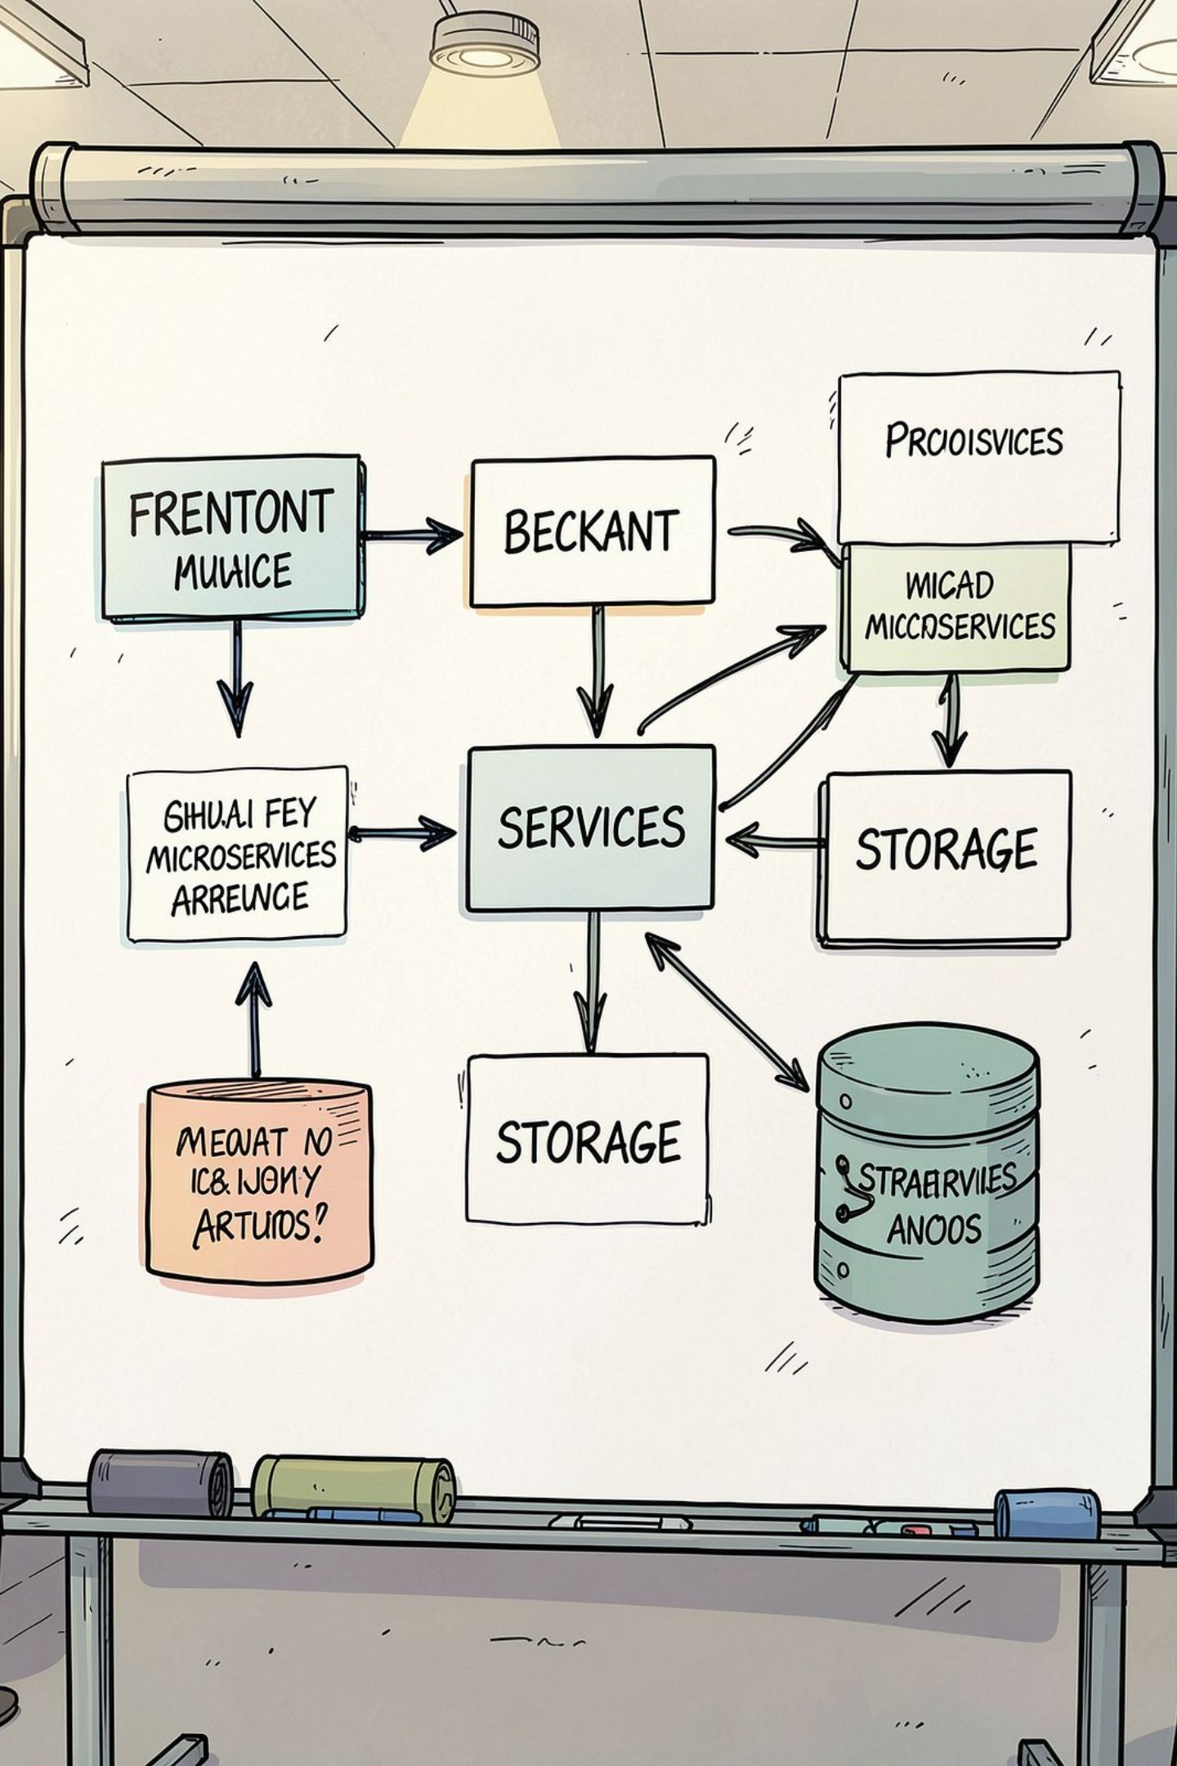
System Architecture
Purpose-built, full‑stack architecture for interactive diagnosis and audit:
Frontend
React 19, Vite, Tailwind — dashboard, input forms, review workflows.
API Layer
FastAPI + Uvicorn — diagnosis routing, validation, history APIs.
Diagnostic Services
Rule validation engine, evidence extractor, CLI parsers, LLM components (future).
Persistence
JSON-based records for rapid prototyping; extensible to databases for production.

Slide 8


Human‑in‑the‑Loop & Explainability
NetSage blends automated reasoning with expert review to build trust and provenance.
Why human review matters
Validates AI recommendations before any config changes.
Prevents unsafe or inappropriate actions on devices.
Provides expert feedback that improves future diagnoses.
Creates auditable records for training and compliance.
AI Diagnosis
Human Reviewer
Auditable Record
Every diagnosis documents: Root Cause → Evidence → Validation checks → Verification command → Remediation steps.

Slide 9


Results & Impact
Students
Guided troubleshooting, faster learning curve, clearer understanding of Cisco IOS commands.
Trainers
Review student work, identify repeating mistakes, tailor lessons to common faults.
Network Engineers
Faster triage, evidence-based recommendations, searchable historical cases for reference.
Impact summary: Faster troubleshooting · Better learning outcomes · Explainable, auditable recommendations · Human oversight retained

Slide 10
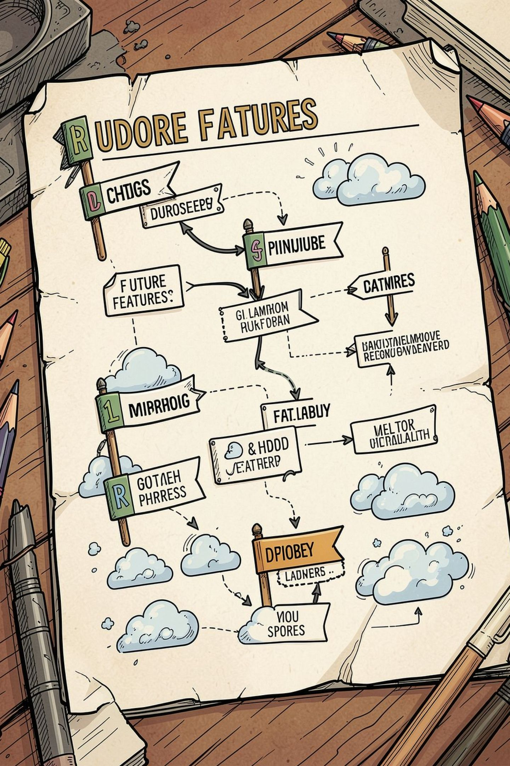
Future Scope & Conclusion
Planned Enhancements
Conclusion
LLM-assisted network analysis for richer natural-language diagnostics.
Packet Tracer topology file parsing and automated evidence extraction.
Production-grade storage, authentication and role-based access.
Real-time collaboration, PDF reports and ticketing integration.
Cloud deployment with CI/CD and scalable services.
NetSage AI transforms trial‑and‑error Packet Tracer troubleshooting into a guided, explainable and auditable workflow. Diagnose smarter, troubleshoot faster, and learn better.
Next step: pilot deployment with instructors and lab classes to refine rules, UX and case coverage.

